Slide 1

SafeMoms
By Team Wellness
Team Wellness Members:
Faith Chimara - Project Manager
Apeji Rita - UX Researcher
Bukola Olabanji - Product Manager
Akinwande Ayoka - Project Manager (Backup)
Muddansir Abubakar Sufiyan - UX Designer

Slide 2
Problem Statement
The Problem: Pregnant women in rural Nigeria face life-threatening delays in accessing timely healthcare due to limited resources, distance, and lack of information.
GCGO Related to the Problem: Healthcare
Why It Matters: Maternal mortality rates in rural Nigeria are among the highest in the world, and most of these deaths are preventable with timely care. Addressing this issue is crucial to improving the health and well-being of mothers and children, ensuring that women receive the care they need during pregnancy to reduce complications and save lives.

Slide 3
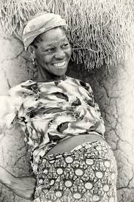
Meet Abisola Olalekan – Affected by the Problem
Abisola Olalekan is a 27-year-old pregnant mother living in a remote village in rural Nigeria. She has limited access to healthcare facilities, and the nearest hospital is miles away, requiring long and costly travel. Due to the lack of transportation, timely medical advice, and resources, she often misses vital check-ups during her pregnancy.
Without regular antenatal care, Abisola is at risk of developing life-threatening complications. She often relies on traditional advice, and by the time she recognizes a serious health issue, it may be too late. This situation endangers both her life and that of her unborn child.

Slide 4
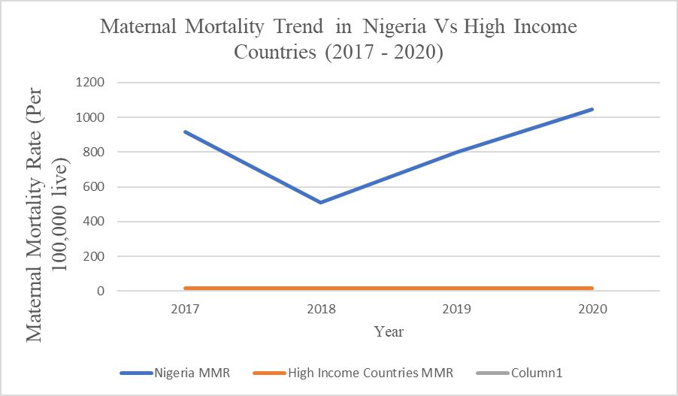
Maternal Mortality Rates – Nigeria vs. High-Income Countries (2017-2020)
Between 2017 and 2020, maternal mortality rates in Nigeria were drastically higher compared to high-income countries. While high-income countries saw a decline to as low as 10 deaths per 100,000 live births, Nigeria's rate remained alarmingly high, averaging 800 deaths per 100,000 live births.
This stark difference highlights the urgent need for improved maternal healthcare in Nigeria.
(Source: World Health Organization, 2021) [Line chart: Mortality Rates in Nigeria vs. High-Income Countries]

Slide 5
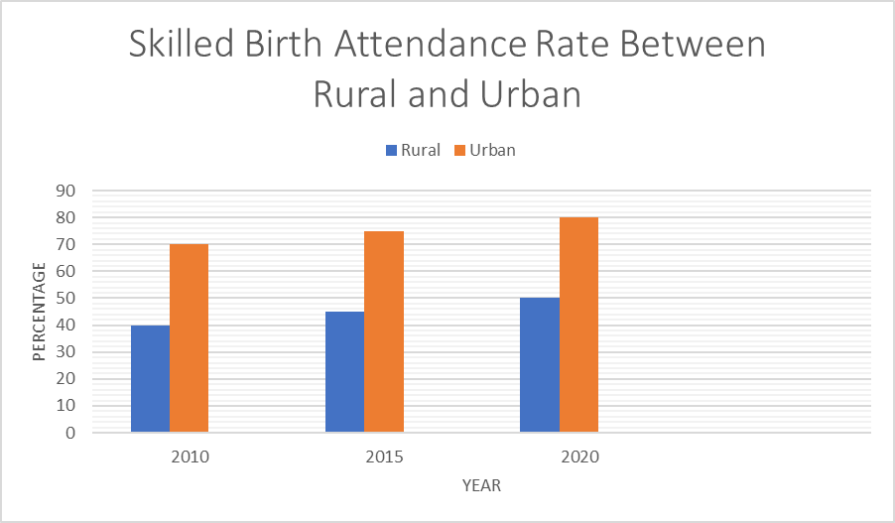
Access to Skilled Healthcare Professionals
In rural Nigeria, only 39% of births are attended by skilled healthcare professionals, compared to 99% in high-income countries. Lack of access to trained medical staff significantly increases the risks for pregnant women and contributes to high mortality rates.
(Source: UNICEF, 2020)

Slide 6
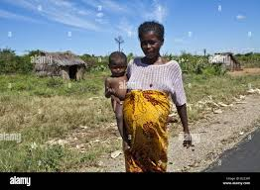
Delay in Access to Healthcare
In rural Nigerian communities, the average delay in seeking care for pregnancy complications can be as long as 8 hours, whereas in urban areas, it’s around 2 hours. These delays are largely driven by several factors: long distances between homes and healthcare facilities, poor road infrastructure that hinders timely travel, and a lack of awareness about the importance of immediate medical care. Many rural women also face barriers such as limited access to transportation, cultural practices that delay decision-making, and a shortage of healthcare workers, which further exacerbates the challenge.
(Source: Nigerian Ministry of Health, 2021)

Slide 7
User Needs and Pain Points
Limited Access to Information:
Users expressed frustration over the lack of reliable health information regarding pregnancy and prenatal care. Many women in rural areas do not know when to seek medical attention or what complications to look out for.
Transportation Challenges:
Users highlighted the difficulty in accessing healthcare facilities due to poor road conditions and lack of transportation. This often leads to delayed medical care, exacerbating health risks for both mothers and their babies.

Slide 8

Proposed Solution – SafeMoms App
SafeMoms is a mobile application designed to empower pregnant women in rural Nigeria with vital health information and support. The app will provide:
Personalized Health Reminders: Regular alerts for check-ups, vaccinations, and important health tips tailored to each stage of pregnancy.
Community Health Worker Connection: Direct access to trained healthcare volunteers who can provide support, answer questions, and help users navigate healthcare services.
Emergency Alerts: Notifications for high-risk symptoms, encouraging timely medical attention.

Slide 9
Why This Solution– SafeMoms App
1. Tailored Support: SafeMoms provides personalized, timely information that addresses the unique challenges faced by pregnant women in rural areas, fostering better decision-making and healthcare-seeking behavior.
2. Community Engagement: By leveraging local healthcare volunteers, the app builds trust within the community, making it easier for users to access help and information when needed. This approach not only enhances knowledge but also improves access to care.
3. Evidence-Based Effectiveness: Research indicates that mobile health interventions significantly improve maternal health outcomes by increasing access to information and services, leading to timely interventions and reducing maternal mortality rates.

Slide 10
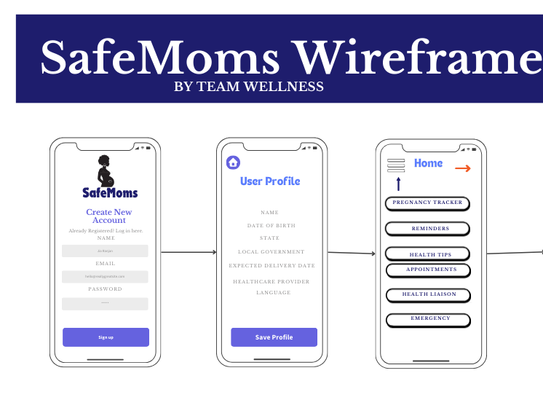
Wireframe– SafeMoms App

Slide 11
Next Steps with Funding– SafeMoms App
1. Finalize and Launch the App:
Development: Collaborate with developers to finalize the app design and features based on user feedback from our initial wireframes.
Testing: Conduct pilot testing in select rural communities to gather user insights and ensure functionality.
2. Training Community Health Workers:
Workshops: Organize training sessions for healthcare volunteers on how to use the app effectively and provide essential prenatal care.
Community Engagement: Foster relationships with community leaders to encourage widespread adoption and trust in the app.
3. Awareness Campaign:
Outreach Programs: Implement community-based campaigns to educate pregnant women about the app’s benefits, ensuring they understand how to use it for their health.
Partnerships: Collaborate with local healthcare providers and organizations to enhance credibility and support for SafeMoms.
4. Monitor and Evaluate Impact:
Data Collection: Set up mechanisms to track app usage, health outcomes, and user satisfaction to assess the effectiveness of SafeMoms.
Continuous Improvement: Use feedback to refine app features and expand its functionality based on the evolving needs of our users.

Slide 12
The Why Behind– SafeMoms App
Why It Matters: Maternal mortality rates in rural Nigeria are alarmingly high, and most of these deaths are preventable with timely and adequate healthcare.
Impact of SafeMoms:
Empowerment: Provides crucial health information, allowing women like Abisola to take charge of their health.
Accessibility: Connects users with community health workers for timely interventions.
Lasting Change: Aims to significantly reduce maternal mortality rates, leading to healthier families and communities.

Slide 13
Appendix– SafeMoms App
Additional Data and Facts:
Global Context:
According to the World Health Organization, approximately 810 women die each day from preventable causes related to pregnancy and childbirth globally.
Similar Solutions:
Health Initiatives: Mobile health applications in countries like India and Bangladesh have successfully reduced maternal mortality by improving access to information and healthcare services.
Unanswered Questions:
What additional features would users find beneficial in the SafeMoms app?
How can we ensure sustained engagement with the app in rural communities?
Organizations Doing Similar Work:
Maternal Health Task Force: Focuses on improving maternal health outcomes through various initiatives and research.
Mobile Alliance for Maternal Action (MAMA): Uses mobile technology to improve maternal and newborn health by providing information to mothers.

